Slide 1
TITLE: Design Of User-friendly Calendar
Name Mrinmoy Sarkar, Lydia Zeleke, Xuyang Yan
NC A&T State University

Slide 2
PROBLEM STATEMENT
Problem Statement
How to design a new user-friendly calendar for hourly activities planning?
What kind of new features need to be considered in the design?
Easier to understand,
Better visualization,
Customize users’ preferences/choices,
Capable to share among users,
Match people with the similar plans/interests,
Provide useful/appropriate suggestions,

Slide 3


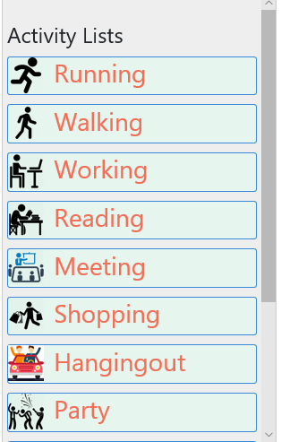





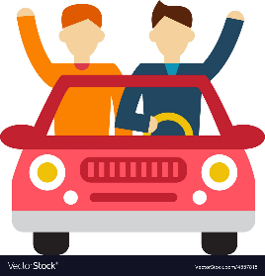
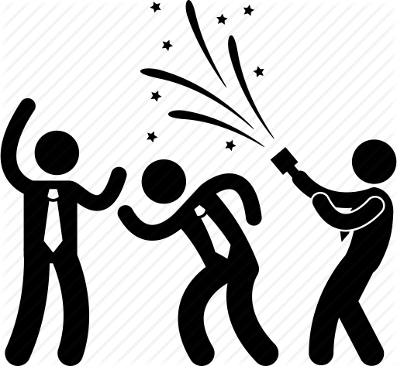

Graphical/Symbolic Representations of Activities:
Running
Walking
Working
Watching TV
Shopping
Air Travelling
Hang out
Party
Meeting

Slide 4
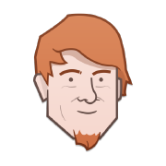
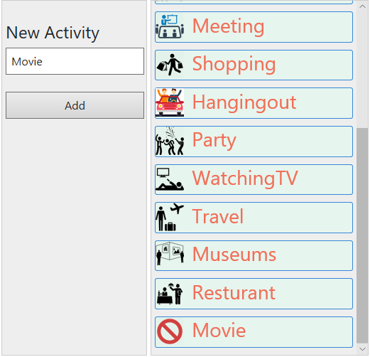
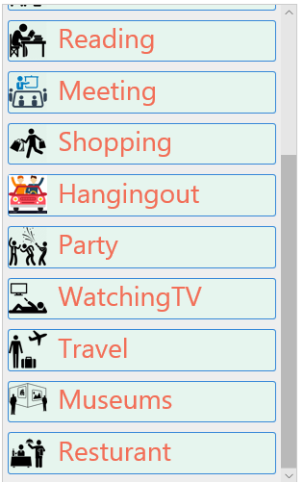
Open-Source Platform for Customizing User Plans:
Here we are ! I have added a new activity to my event database
Well, my planned activities is not in the list, let me add it here

Slide 5
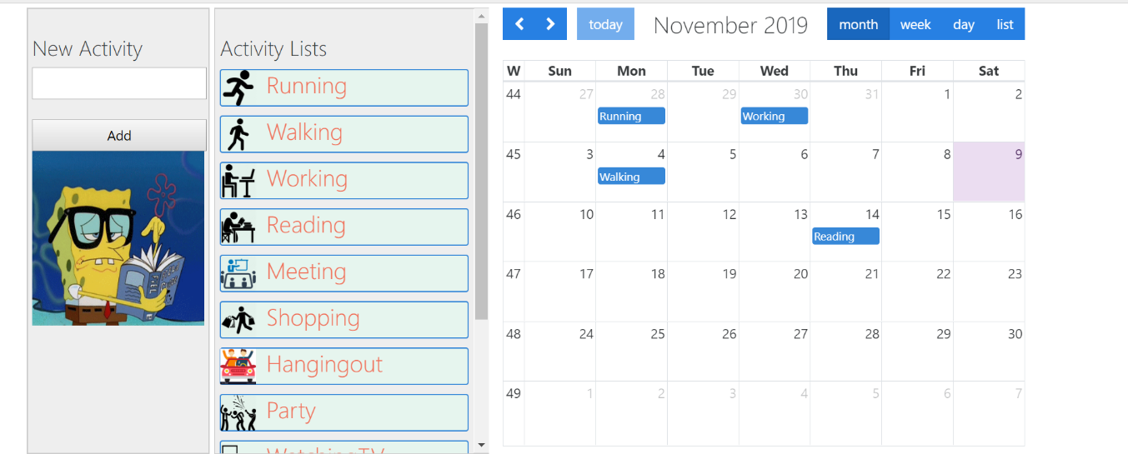
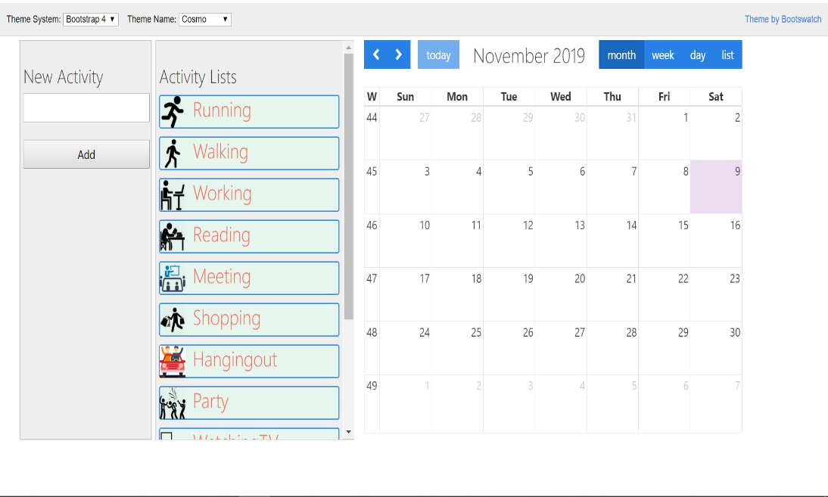
Visualization of the Activities:

Slide 6
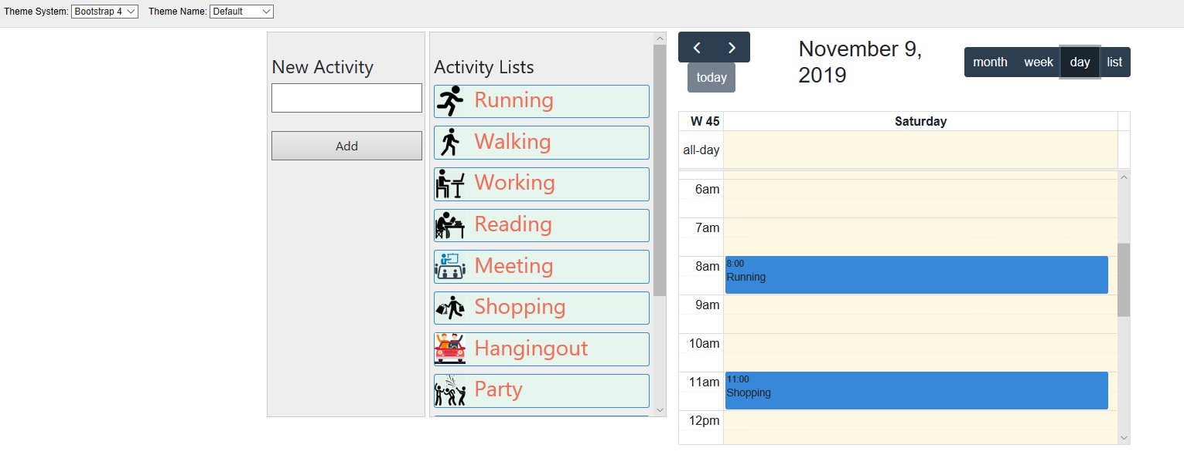
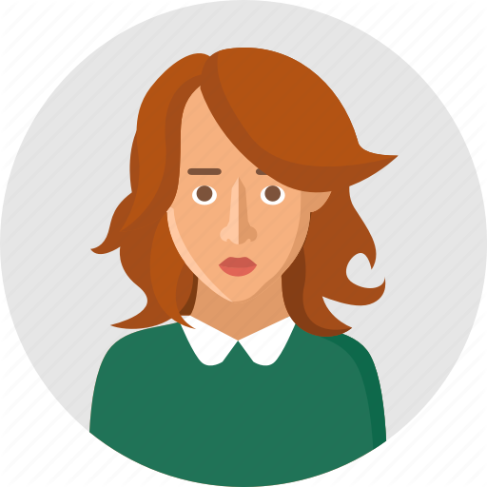

Partner Matching and Group Activities Planning :
Plans: Visits the Art Museum
Extreme Events
……
Listen to the concert
Plans: Visits the Art Museums
Bungy jumping
….
Go to concert

Slide 7
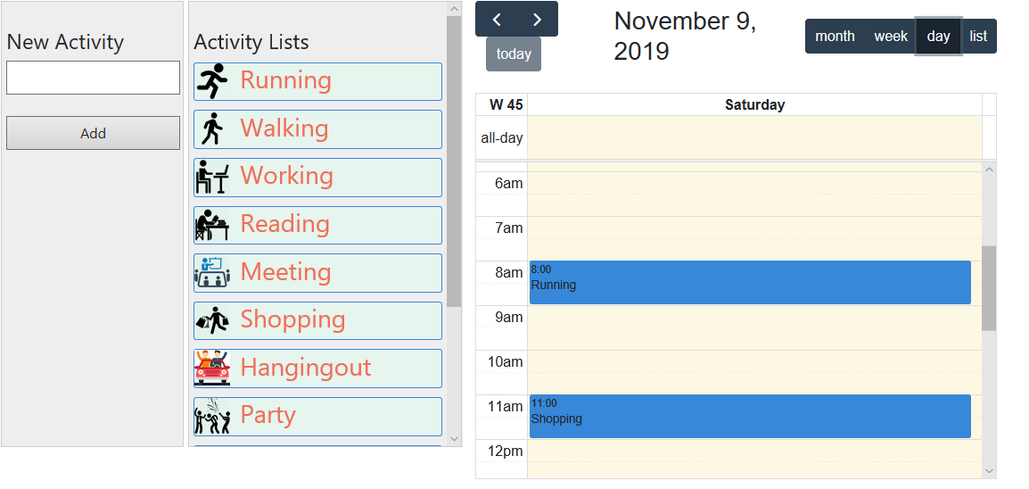
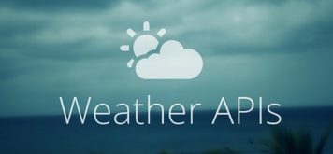
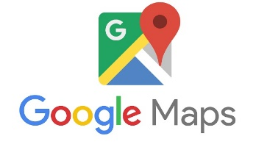
Suggestions for Better Activities Planning:
It will be rainy around 8am, it is better to stay at home !
Well, the friendly shopping center will be busy at 11am, go to four seasons mall is better !

Slide 8

Q&A
Thank you

